Slide 1
Budget Hearings Presentation May 4, 2015

Slide 2
Presentation Overview
Who we are
LA Income Inequality, Public Sector Role
Wall Street Crash = Service Cuts that Hurt
Recovery Room, Structural Solutions Beyond Band-Aids

Slide 3
Who We Are Fix LA Coalition
5/15/15
3

Slide 4
Who we are: Fix LA purpose
Fix LA Coalition, formed in 2014.
Coalition of LA Unions joined with Community and Faith based organizations to:
Reclaim Revenue
Restore Services
Promote creation of Good Jobs for Angelenos
Address Public Safety issues

Slide 5
Fix LA-City Union Member Demographics
Coalition of LA City Unions
65% of the City Council Controlled Civilian workforce
51% are LA City residents
74% do pink and blue collar work
55% est. positions are Special Funded
66% are 46 and older
55% of our workers are Special Funded.
2/3rd Full Time, 1/3rd Part Time in low wage, unbenefited positions.

Slide 6
LA Under Employment National High
Source: Bureau of Labor Statistics “Alternative Measure of Labor Under Utilization for States”

Slide 7
46% of Angelenos Make < $15/Hour
Not enough for a single adult to subsist without relying on public assistance
California Budget Project Basic Household Budgets
Single parent family household = $77,546
Two parent family household = $83,561

Slide 8
Public Sector = LA’s largest Industry
Public Sector = LA’s largest industry
Employer | # Employees
City of Los Angeles | 44,947
County of Los Angeles | 40,691
Los Angeles Unified School District | 36,881
UCLA | 32,300
Cedars Sinai Medical Center | 17,000
USC | 16,623
Kaiser Foundation Hospitals | 11,775
Veterans Health Administration | 10,400
Farmers Insurance Group | 9,167
Team One Employment Specialists LLC | 5,000
US Postal Service | 1,500
*CAFR FY 12. CAFR FY 13 only lists private employers, none near 40,000
City of Los Angeles Comprehensive Audited Financial Report FY 11-12
8

Slide 9
Public Sector Job Recovery Slower than Ever in California
California’s state and local government job for three recessions per California Public Employee Relations analysis of BLS CES data.

Slide 10
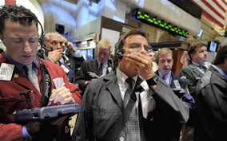
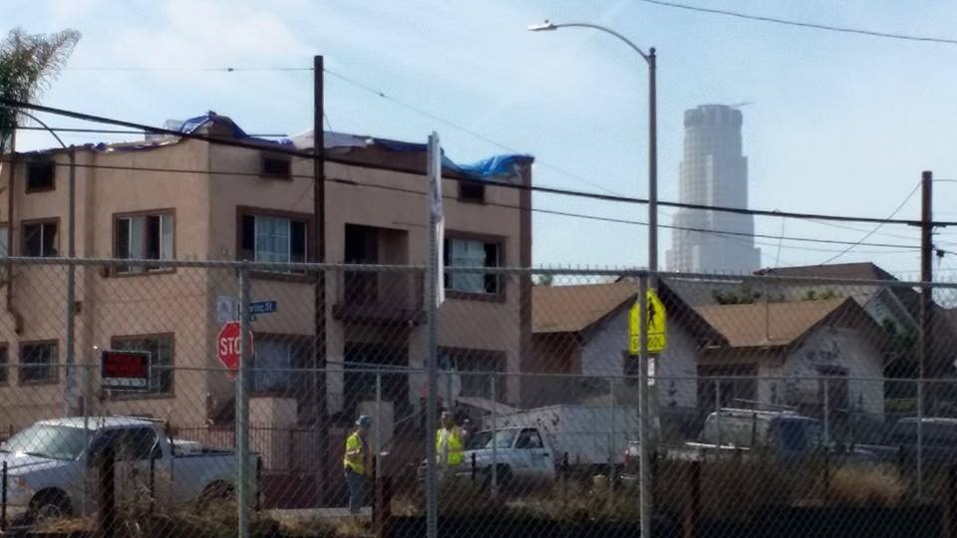
What Happened?
Wall Street crashed the economy.
City of Los Angeles’ expected civic prosperity took a $3 billion nosedive, deepening the divide between Angelenos.

Slide 11
Gone: 16% of the City’s main work force
Dropped 5,800 civilian workers in Council Controlled departments.
Lost providers of basic services for residents.

Slide 12
58% increase in City use of temp jobs
Source: Controller data provided by CAO

Slide 13
“As Needed” Coalition Workers 2014
1/3 of all Coalition of LA Union Members

Slide 14
Service Crisis: 43% drop in catch basin cleaning
Sanitation lost capacity to keep trash and debris out of Santa Monica Bay.

Slide 15
City All But Stopped Clearing Fire Hazards from Vacant Land

Slide 16
Alleyway cleaning by Street Services and Sanitation dropped by 58%

Slide 17
Directing-Traffic Hours Plunged

Slide 18
Traffic Sign Repair Dropped 93%

Slide 19
Recreation and Parks
“Charge Back” drains $18m from the Department, an austerity tool that needs to be phased out to fund programming.
Needs 30 more park rangers to keep parks safe. Budget offers 10.
Losing 10 full time recreational programming staff.
No growth of maintenance workers for park facilities. Budget offers staff growth of one third of one percent.
Funding for programming at City project housing is flat. Mar Vista lost its park services last year and is not restored.

Slide 20
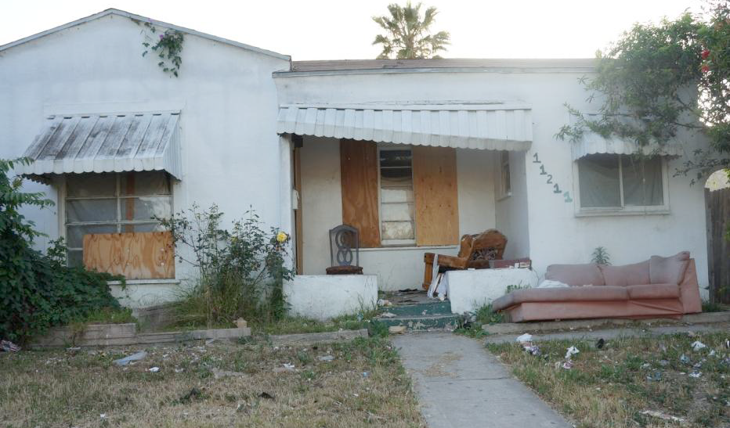
Blight
Building & Safety
40 code enforcement officers down from 125.
Budget removes 6 foreclosure blight inspectors

Slide 21
School-kids Unprotected at 169 Busy Street Crossings
The department’s own traffic studies show 507 intersections near elementary schools need crossing guards. The city fails to staff 169 of them.
That means the city needs at least 169 more crossing guards.
The budget offers five. Not even a Band-Aid.

Slide 22
Crossing Guards protecting elementary school children declined by 37%
Sources: LA City budget documents showing “actual” staffing levels from 2003 through 2007 and “adopted” staffing levels from 2008 through 2012. LA City Controller payroll records for 2013 and 2014.

Slide 23
Mechanic Deficit
General Services
Down 23 mechanics and can’t keep city vehicles on the street. The budget offers one.

Slide 24
Tree Trimming Services Slashed

Slide 25
Myths of Outsourced Work
“Cheaper” – Not in the long run
Marketplace prices rise as City forces drop.
Private contractors have a less flexible workforce. Contract defined for specific service. City street crews can be deployed for multiple functions.
“Faster” – Bad for quality service delivery
Quality loss. City workers driven by service goals, not profit motive.
City often has not had adequate staffing to supervise contractors.

Slide 26
Create a $15 an Hour Minimum Wage to Spur Economic Growth
Raising the minimum wage to $15 would produce billions of dollars annually in local economic growth.
It would likely create tens of thousands of new jobs and create hundreds of millions of dollars in tax revenue growth for state and local governments.
Workers suffering from insufficient contractor enforcement. Wage theft from workers estimated $26 million per week.
That would be enough to pay for enforcement to make sure employers don’t break the law by not paying Angelenos their full wages.

Slide 27
Improve Public Safety and Save Taxpayer Dollars by increasing LAPD Civilians
Police department civilian staff down by 16%.
City has called for civilianization and added 86 positions
Progress with 88 new Clerical positions, .
No new detention officer positions in the proposed Budget.
Jails have property rooms with no property room workers. No increase to 68 civilian Property Officers.
LAPD has been forced to take officers off patrol to do civilian work, including 90 officers removed from the field to work in city jails.

Slide 28
Things to do for recovery
Stimulate economy by raising the minimum wage to $15 an hour and cracking down on wage theft.
Save money and enhance public safety by stopping the use of higher-paid police officers to do civilian work.
Aggressively work to reform Prop 13
Negotiate better deals with Wall Street
Use more of LA’s record-high reserves to hire more Angelenos into good, career ladder City jobs.

Slide 29
Corporations Pay Their Fair Share
Continue addressing unintended consequence of Prop 13, which allowed commercial property owners to shift more of the tax burden onto homeowners.
Estimate that the City loses over $200 million per year in commercial property not assessed at fair market value.
Encourage City public campaign to educate Angelenos about the need for corporations to pay their fair share of property taxes by having commercial properties assessed at fair market value.

Slide 30
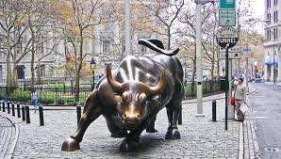
Take the Wall Street Bull by the Horns!
TO DO LIST:
Figure out how much the city is paying Wall Street. At least $300 million a year.
Use our collective clout to negotiate lower fees.
In-source expertise.
Demand our money back from unfair deals.
Refuse to give business to uncooperative banks.

Slide 31
New York City wrangling the Bull
New York City’s Comptroller Scott Stringer found that his city’s five pension funds have paid more than $2 billion in fees.
“We asked a simple question: Are we getting value for the fees we’re paying to Wall Street?” Stringer said. “The answer, based on this 10-year analysis, is no.”

Slide 32
Whistle Blowing on Hidden Fees
Respected Consulting Firm CEM Benchmarking recent groundbreaking report
Concluded most public pension funds don’t even know how much they are paying to Wall Street.
Found most private equity investment costs are NOT being disclosed.

Slide 33
LA Needs to Stand Up to Unfair Deals
Nearly a year after the City Council voted 14-0 to renegotiate the city’s unfair deal with Bank of New York Mellon and Dexia, the banks continue to gouge taxpayers with impunity.
It’s time to withdraw all of our city’s business unless they agree to treat us fairly.

Slide 34
Use Record-High Reserves to Fix LA

Slide 35
“Spend the money!” On services
City leaders have encouraged Department GM’s not to sit on money this year.
We encourage Committee and Council to not sit on ample reserves.
Residents need more services than budgeted. The robust reserve surplus should fund more services.
CAO argues against tapping record high reserves because they help the city get good deals from Wall Street:
”reserve funds are an integral consideration in determining a city’s creditworthiness for debt issuance.”
”the level of a city’s reserve correlates highly with [credit] rating level [and lower borrowing costs]”
But CAO report shows LA far ahead of NYC, which has AA bond ratings.

Slide 36
Where LA reserves fit with other cities
Note: Chicago and San Diego are higher than most due to unique circumstances.
Source: CAO Report, “Reserve Funds of the Ten Largest Cities in the United States,” 2/5/2014

Slide 37
Solutions in summary
Stimulate economy by raising the minimum wage to $15 an hour and cracking down on wage theft.
Save money and enhance public safety by stopping the use of higher-paid police officers to do civilian work.
Aggressively work to reform Prop 13
Negotiate better deals with Wall Street
Use more of LA’s record-high reserves to hire more Angelenos into good, career ladder City jobs.

Slide 38
DISCUSSION

